Slide 1
Design & Analysis of Algorithm Graph Theory
Informatics Department
Parahyangan Catholic University

Slide 2
Definition
A Graph G=(V,E) consists of a set of objects V={v₁, v₂, ...} called vertices, and another set E={e₁, e₂, ...}, whose elements are called edges, such that each edge e_{k} is identified with an unordered pair (v_{i}, v_{j}) of vertices.
Commonly represented by a diagram:
Vertices -> points
Edges -> line segments joining its end vertices

Slide 3
Example
e₁
e1 is called self loop
e4 and e5 are called parallel edges
A graph without self loop or parallel edges is called a simple graph
v₁
e₃
v₂
e₅
e₄
e₂
v₅
e₇
v₃
e₆
v₄

Slide 4
A graph may be drawn differently

Slide 5
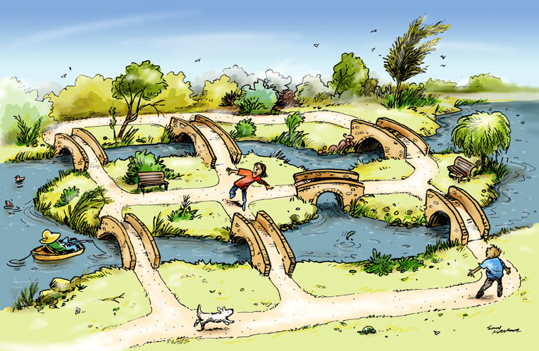
Application : Konigsberg Bridge
Notes:
This problem is the same as the problem of drawing figures without lifting the pen from the paper and without retracing a line

Slide 6

Application : Utilities Problem
Water
Electricity
Gas
Notes:
3 houses, 3 resources. Can we draw the supply line without crossing each other ? Answer is “no” (planarity problem)

Slide 7
Application : Utilities Problem
Water
Electricity
Gas
Notes:
3 houses, 3 resources. Can we draw the supply line without crossing each other ? Answer is “no” (planarity problem)

Slide 8
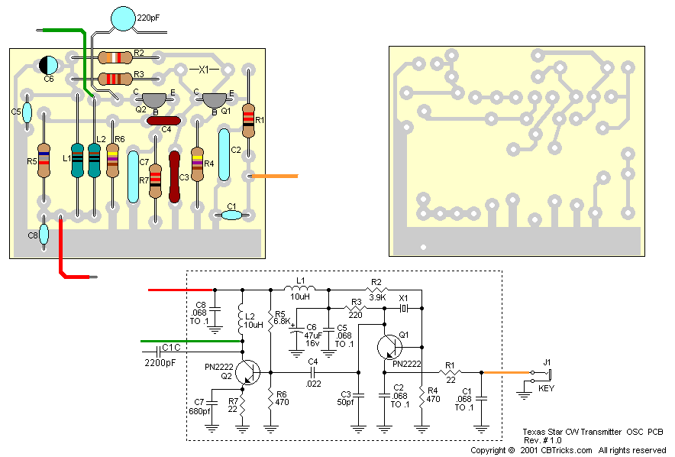
Application : Electrical Network

Slide 9
Application: Seating Problem
2
3
Nine members of a new club
meet each day for lunch at a round table. They decide to sit such that every member has different neighbor at each lunch. How many days can this arrangement last ?
1
4
9
5
8
6
7
Notes:
Answer: 4. Other arrangements are : (1573928461), (1795836241)

Slide 10
Exercise
3
4
Given a maze as shown on the left. Represent this maze by means of a graph such that a vertex denotes either a corridor or a dead end (as numbered). An edge represents a possible path between two vertices.
7
8
13
12
11
14
1
2
21
22
18
17
6
5
19
20
15
16
10
9

Slide 11
Incidence and Degree
When a vertex v_{i} is an end vertex of some edge e_{j}, v_{i} and e_{j} are said to be incident with each other.
The number of edges incident on a vertex v_{i}, with self-loop counted twice, is called the degree, d(v_{i}), of vertex v_{i}

Slide 12
Example : Degree
e₁
v₁
e₃
v₂
d(v₁) = 3
d(v₂) = 4
d(v₃) = 3
d(v₄) = 3
d(v₅) = 1
e₅
e₄
e₂
v₅
e₇
v₃
e₆
v₄
Since each edge has two incident vertices, the total degree of all edges in a graph is 2*(#of edges), which is always even. So the number of vertices that has odd degree is also even.

Slide 13
Walk
A walk is defined as finite alternating sequence of vertices and edges, beginning and ending with vertices, such that each edge is incident with the vertices preceding and following it
No edge appears more than once
A vertex may appear more than once

Slide 14
Example : Walk
e₁
v₁
e₃
v₂
e₅
e₄
e₂
v₅
e₇
v₃
e₆
v₄
v₁, e₄, v₃, e₅, v₁, e₃, v₂, e₂, v₄ is a walk

Slide 15
Walk
A walk which starts and ends at the same vertex is called closed walk.
Non-closed walk is called open walk.
e₁
v₁
e₃
v₂
e₅
e₄
e₂
v₅
v1, e3, v2, e1, v2, e2,
v4, e6, v3, e4, v1
is a closed walk
e₇
v₃
e₆
v₄

Slide 16
Path and Circuit
An open walk in which no vertex appear more than once is called a path
A closed walk in which no vertex (except the starting and ending vertex) appear more than once is called a circuit

Slide 17
Example : Path and Circuit
e₁
v₁
e₃
v₂
v3, e4, v1, e3, v2, e2, v4
is a path
e₅
e₄
e₂
v₅
e₇
v₃
e₆
v₄

Slide 18
Example : Path and Circuit
e₁
v₁
e₃
v₂
v3, e4, v1, e3, v2, e2,
v4, e6, v3 is a circuit
e₅
e₄
e₂
v₅
e₇
v₃
e₆
v₄

Slide 19
Graph Connectivity
A graph G is said to be connected if there is at least one path between every pair of vertices in G.
Disconnected graph consist of two or more connected sub-graph. Each of these connected sub-graph is called a component.

Slide 20
Example : Disconnected Graph
Component #2
Component #1

Slide 21
Euler Graph
In 1736, Euler solved Konigsberg bridge problem.
Generally, in what type of graph G is it possible to find a closed walk running through every edge of G exactly once ?
Such a walk is now called an Euler line, and a graph that consist of an Euler line is called an Euler Graph.
Theorem
A given connected graph G is an Euler graph if and only if all vertices of G are of even degree.

Slide 22
Hamiltonian Path and Circuit
Hamiltonian circuit in a connected graph is defined as a closed walk that traverses every vertex of G exactly once (except the starting vertex).
If we remove any one edge from a Hamiltonian circuit, we are left with a Hamiltonian path.

Slide 23
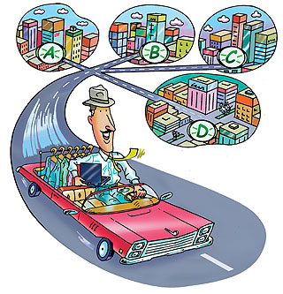
Example

Slide 24
Exercise
Given 10 domino pieces:
[1,2] , [1,3] , [1,4] , [1,5] , [2,3] ,
[2,4] , [2,5] , [3,4] , [3,5] , [4,5]
Discuss how to arrange the pieces such that one number of the tile always touches the same number on its neighbor
Model this problem in term of graph

Slide 25
Weighted Graph
Edges of a graph may have a weight
Less commonly, vertices can have a weight too
Example: A graph that represent a map of cities. Edges represent cities’ connectivity, and the edge’s weight represent the distance between cities.
Example problem: Find Hamiltonian circuit with smallest distance travelled.

Slide 26
Directed Graph
Edges of a graph may have direction. Such graph is called directed graph (or digraph).
In digraph, an edge is not only incident on a vertex, but also incident out of a vertex and incident into a vertex
e₁
e₁ is incident out of v₁
e₁ is incident into v₂
v₂
v₁

Slide 27
Directed Graph
The number of edges incident out of a vertex v_{i} is called out-degree, and is written d⁺(v_{i})
The number of edges incident into a vertex v_{i} is called in-degree, and is written d⁻(v_{i})

Slide 28
Exercise
When is a digraph an Euler digraph ? (i.e., we can start from a vertex, visit every edges exactly once, and come back to the starting vertex)

Slide 29
Tree
A tree is a connected graph without any circuits
Trees do not have a self-loop or parallel edges, because they both form circuits
Example:

Slide 30
Tree Properties
There is one and only one path between every pair of vertices in a tree
A tree with n vertices has n-1 edges
A connected graph with n vertices and n-1 edges is a tree

Slide 31
Spanning Tree
A tree T is said to be a spanning tree of a connected graph G if T is a sub-graph of G and T contains all vertices of G.
Since a tree must be connected, disconnected graph cannot have a spanning tree.
However, each component has a spanning tree, thus a disconnected graph of k components has a spanning forest consisting of k spanning trees (a collection of tree is called forest).

Slide 32
Spanning Tree
Example:

Slide 33
Spanning Tree
An edge in spanning tree T is called a branch of T.
An edge of G that is not in a given spanning tree T is called a chord.
We know that a tree of n vertices has n-1 edges.
So a spanning tree T of G with n vertices and e edges must have (n-1) branches and (e-n+1) chords.

Slide 34

Exercise
A farm consisting of six walled plots of land. These plots are full of water, how many walls will have to be broken so that all the water can be drained out ? Model this problem in term of graph !

Slide 35
Rooted Tree
A tree in which one vertex (called the root) is distinguished from all the others is called a rooted tree
Example:

Slide 36
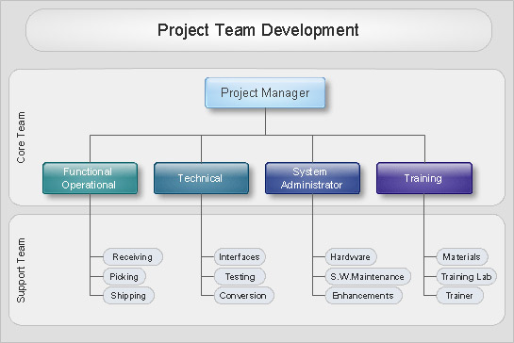
Rooted Tree Example
Organizational Structure

Slide 37
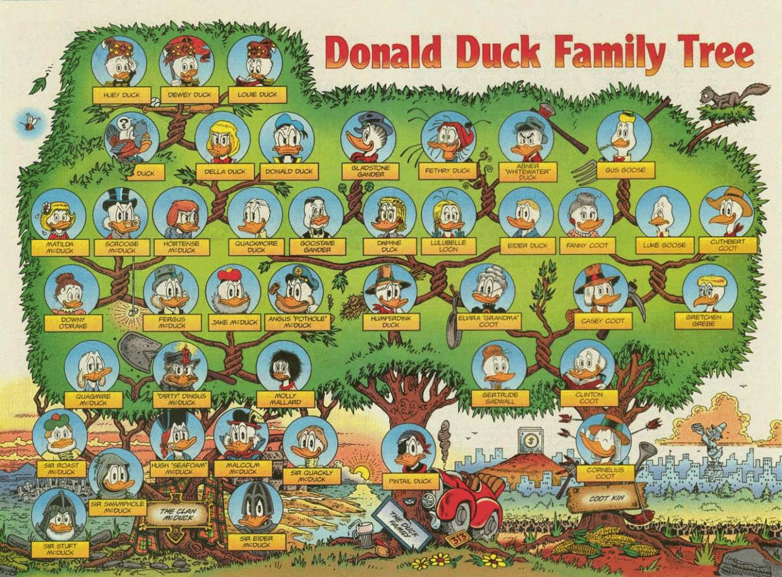
Rooted Tree Example
Family Tree

Slide 38
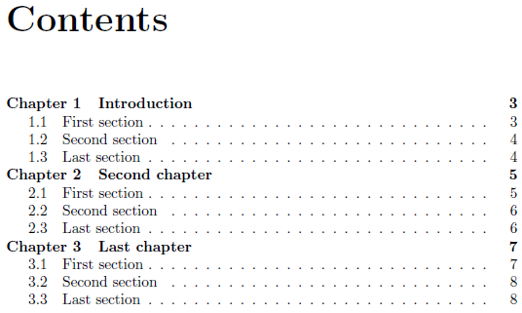
Rooted Tree Example
Book’s table of contents

Slide 39
Parent and Child Relation
root
parent
internal node
child
leaf

Slide 40
Rooted Tree
The root has no parent, every other node has exactly one parent
Parent of a node x is the node directly connected to x but closer to the root
If x is the parent of y, then y is the child of x
If x is as close to the root as y, then x and y belong to the same level
The depth of a tree is the distance of the farthest node from the root

Slide 41

Graph & Tree Traversal
Traversal means for “traveling” systematically through a graph/tree, visiting each vertex exactly once
Depth First Search (DFS)
Breadth First Search (BFS)

Slide 42
Graph & Tree Traversal
Since every vertex only visited once, traveling through a graph might not visit every edges
Example:
this edge is not visited
start here
In fact, traversing through a graph produces a traversal rooted tree
(starting vertex is the root)
In connected graph, the traversal tree is also a spanning tree

Slide 43
DFS Traversal on a Tree
DFS traverses down to leaf first, then to siblings
A
A
C
B
C
B
H
D
H
D
G
E
F
I
G
E
F
I
DFS :
A
B
D
E
F
I
H
G
C

Slide 44
BFS Traversal on a Tree
BFS traverses the tree level by level
A
A
C
B
C
B
H
D
H
D
G
E
F
I
G
E
F
I
BFS :
A
B
C
D
H
E
F
I
G

Slide 45
DFS Traversal on a Graph
DFS Tree
A
A
A
B
B
C
C
H
D
I
D
F
F
G
F
G
E
B
E
E
H
D
C
H
I
I
G
DFS :
A
H
I
F
E
D
B
C
G

Slide 46
BFS Traversal on a Graph
BFS Tree
A
A
A
B
B
C
C
H
B
D
D
F
F
G
G
I
F
G
C
E
E
E
H
H
I
I
D
BFS :
A
H
B
I
F
G
C
E
D

